Slide 1




Name of the intern :rounak saha branch/institute :ece/iem Kolkata guide :dR.sujoy kumar biswas internship institute :ideas-isi Kolkata duration :14.01.2025-30.04.2025 github repository :: https://github.com/rounak393/autopace
Autopace-traffic speed detection using yolov8

Slide 2
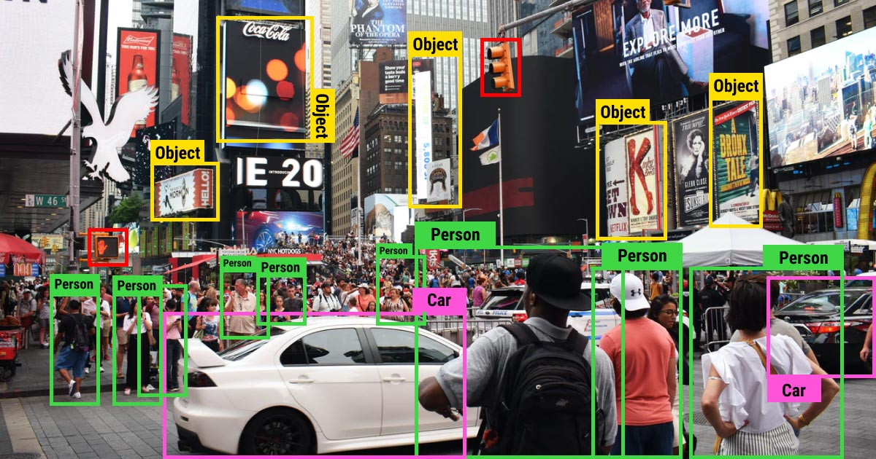
introduction
Traffic speed monitoring is vital for ensuring road safety and enforcing traffic laws. Traditional systems often rely on expensive hardware like RADAR or LIDAR, which can be cost-prohibitive and difficult to deploy at scale. AUTOPACE is an AI-powered solution that leverages computer vision and deep learning to detect and calculate vehicle speeds from video footage. Using the YOLOv8 object detection model and OpenCV, this project presents a lightweight, real-time method for tracking vehicles and estimating their speeds based on their movement across defined frame regions.

Slide 3
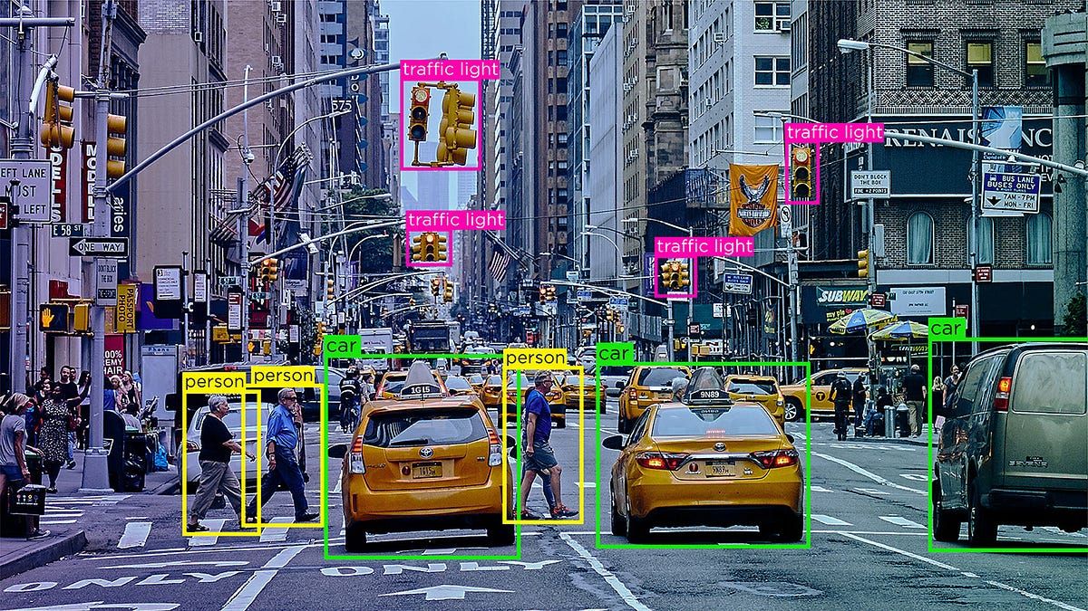
Objectives:
Here are four key objectives of the AUTOPACE project:
Real-Time Vehicle Detection: Utilize the YOLOv8 object detection model to accurately detect and classify vehicles in traffic surveillance videos.
Speed Estimation without Physical Sensors: Calculate the speed of moving vehicles using frame-based time and distance analysis, eliminating the need for RADAR or LIDAR.
Efficient Frame Processing: Implement a streamlined pipeline using OpenCV for video handling and processing to ensure high performance and scalability.
Visual Feedback and Annotation: Overlay detection results, speed estimates, and bounding boxes directly on the video frames to provide clear and interpretable outputs.

Slide 4


Tools and technologies: the tools and technologies used in the AUTOPACE project: YOLOv8 (You Only Look Once Version 8) Deep learning model for real-time object detection. Python Core programming language used for building the application logic. OpenCV (Open Source Computer Vision Library) Used for video capture, frame processing, drawing overlays, and image manipulation. Ultralytics Library Python package that facilitates loading and running YOLOv8 models easily. Google Colab Cloud-based development environment used for executing and testing the project code. Torch (PyTorch) Backend deep learning framework used for running the YOLOv8 model. NumPy & Time Modules Used for mathematical computations and time-based speed estimations. GitHub Version control and project code repository platform. 🔗 GitHub Repository

Slide 5
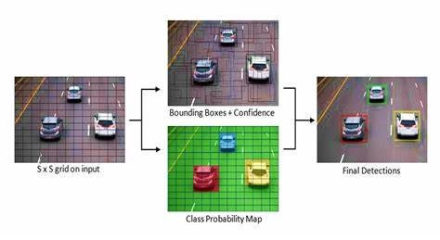
methodology:
Video Processing: Traffic footage is loaded and resized using OpenCV for consistent frame analysis.
Vehicle Detection: YOLOv8 detects vehicles (specifically cars) in each frame with high confidence.
Line Crossing Logic: A virtual line is drawn, and the frame recorded when a vehicle crosses it.
Speed Calculation: Speed is estimated using the time taken to cross a known distance, based on frame rate.
Annotation & Output: Bounding boxes, class labels, and calculated speeds are overlaid and saved in an output video.

Slide 6
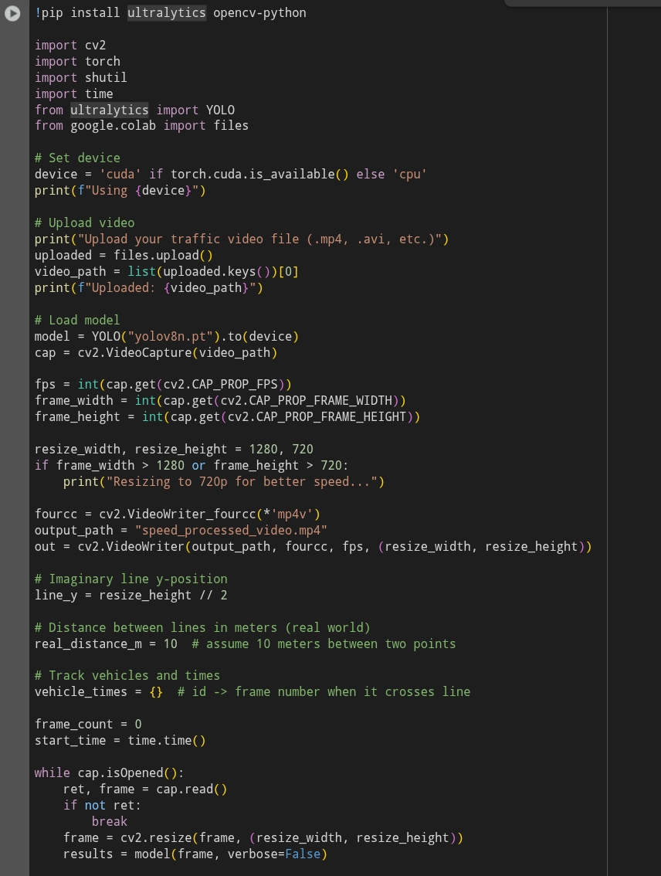
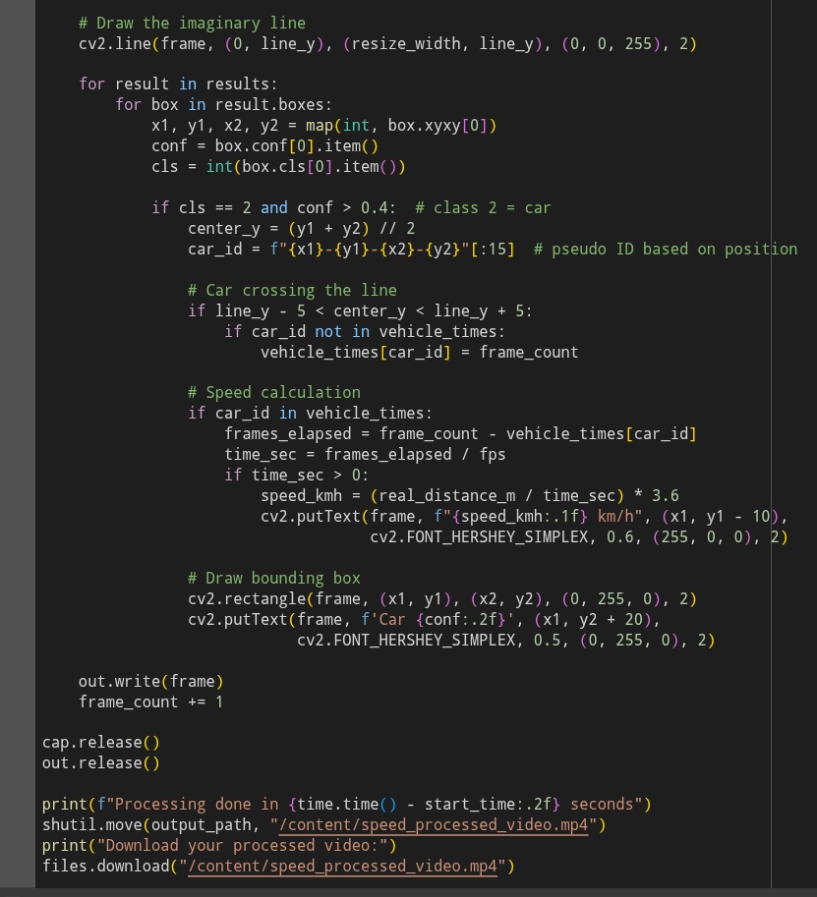
Code extracts:

Slide 7
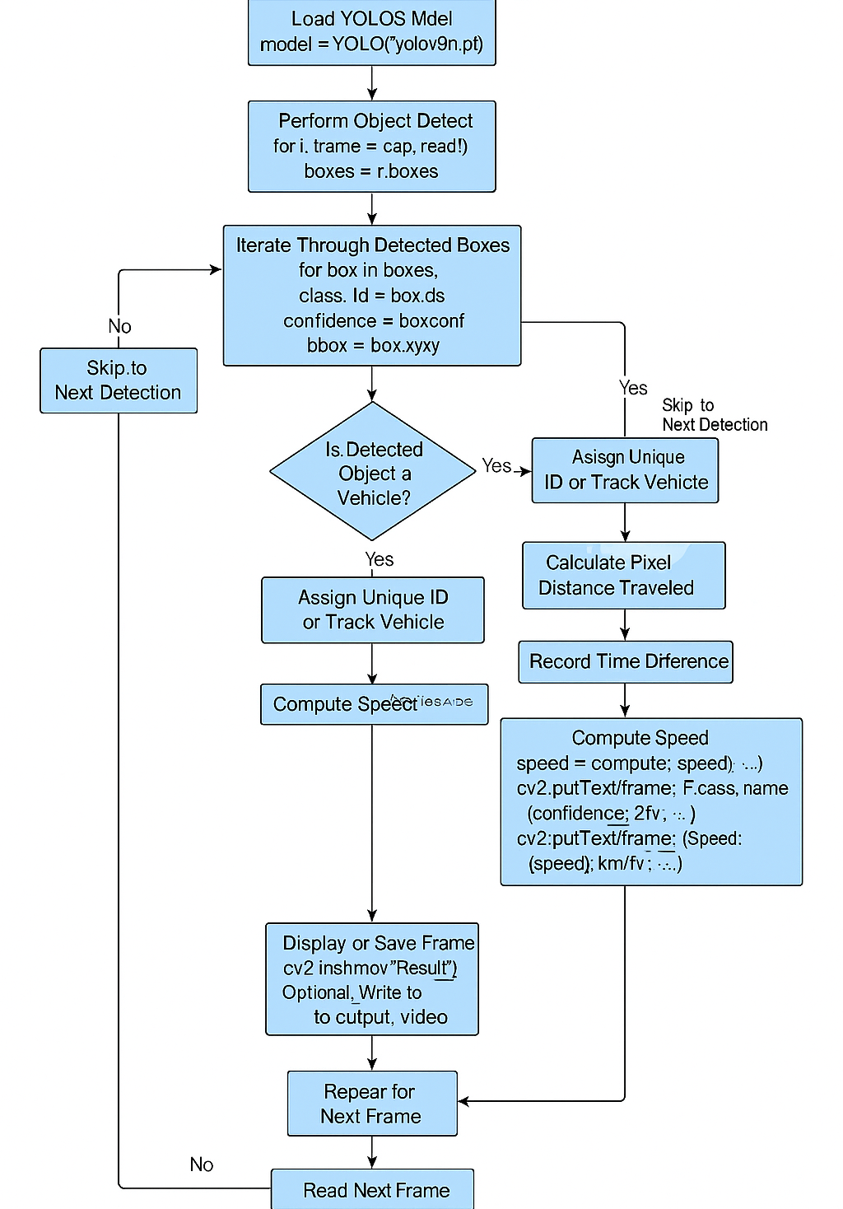
Vehicle Speed Detection Flow – Summary
Load YOLOv9 model for object detection.
Read video frames and detect objects.
Filter for vehicles using class ID.
Assign unique ID or track each vehicle.
Calculate pixel movement and time difference.
Compute speed (distance/time).
Annotate and display/save the frame.
Repeat for each frame until video ends.

Slide 8
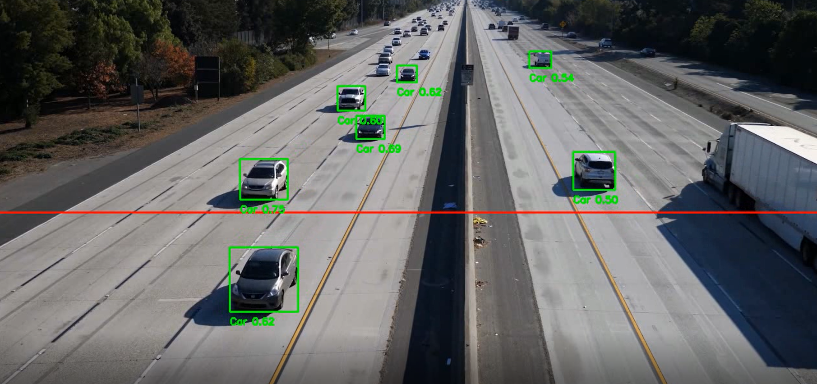
DATA ANALYSIS AND RESULTS:
Two processed video frames were analyzed to evaluate the system:
Vehicle Detection: YOLOv8 accurately detects multiple vehicles with confidence scores ranging from 0.62 to 0.75, clearly outlining each with bounding boxes.
Tracking and Line Crossing: A red horizontal line is drawn as the reference point for speed measurement. When vehicles cross this line, their entry time is logged.
Speed Estimation: The system calculates vehicle speed using the time taken to cross the detection line and a known real-world distance, displaying results directly on the video frame.
Insights: The system shows consistent tracking and accurate speed annotation without any physical sensors. It proves effective for real-time traffic monitoring and enforcement.

Slide 9
Conclusion and results:
The AUTOPACE project successfully demonstrates the capability of using computer vision and deep learning to estimate vehicle speeds in real time from traffic videos. By leveraging the YOLOv8 object detection model, the system accurately detects vehicles and computes their speeds based on frame analysis and virtual line crossing logic.
Key Results:
Real-time detection of multiple vehicles with high confidence.
Speed estimation achieved using frame-based timestamping and known distance calibration.
Accurate annotation of speed on each frame without the need for physical speed sensors.
Conclusion:
This approach provides a scalable, low-cost, and efficient alternative to traditional speed detection methods like RADAR or LIDAR. AUTOPACE can be deployed in smart cities for traffic monitoring, law enforcement, and data collection, making it a valuable tool in intelligent transportation systems.

Slide 10
Acknowledgement:
I would like to express my sincere gratitude to all those who supported and guided me throughout the course of my internship project titled “AUTOPACE – Traffic Speed Detection Using YOLOv8.”
Firstly, I extend my heartfelt thanks to my mentor, Dr. Sujoy Kumar Biswas, whose expert guidance, constructive feedback, and consistent encouragement were invaluable during the development of this project. His insights helped me approach problems with clarity and confidence.
I would also like to thank IDEAS – Institute of Data Engineering, Analytics and Science Foundation, ISI Kolkata, for giving me the opportunity to work on this project as part of my internship. The exposure to cutting-edge technology and research-oriented work has been a significant milestone in my academic journey.
I am grateful to the Department of Electronics and Communication Engineering, IEM Kolkata, for nurturing my technical background and supporting my academic aspirations.
During the course of this project, I benefited greatly from several online resources and open-source tools. I would like to acknowledge the following platforms and documentation that played a crucial role in my development process:
OpenCV for image and video processing: https://docs.opencv.org/
YOLOv8 by Ultralytics for object detection and tracking: https://docs.ultralytics.com/
NumPy and Python libraries for scientific and mathematical computations: https://numpy.org/doc/ https://docs.python.org/3/
GitHub Repository (for project version control and code sharing): https://github.com/
Finally, I am thankful to my peers, friends, and family for their moral support and constant motivation throughout the internship.
This project has been a rewarding learning experience, and I am deeply appreciative of all those who contributed to its successful completion.

Slide 11
Presentation End
Thank you!
Notes:
You can use this slide as your opening or closing slide. Should you choose to use it as a closing, make sure you review the main points of your presentation. One creative way to do that is by adding animations to the various graphics on a slide. This slide has 4 different graphics, and, when you view the slideshow, you will see that you can click to reveal the next graphic. Similarly, as you review the main topics in your presentation, you may want each point to show up when you are addressing that topic.
Add animation to images and graphics:
Select your image or graphic.
Click on the Animations tab.
Choose from the options. The animation for this slide is “Split”. The drop-down menu in the Animation section gives even more animations you can use.
If you have multiple graphics or images, you will see a number appear next to it that notes the order of the animations.
Note: You will want to choose the animations carefully. You do not want to make your audience dizzy from your presentation.

